Slide 1
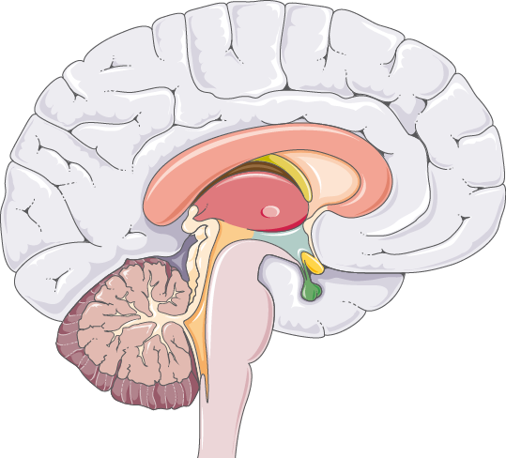
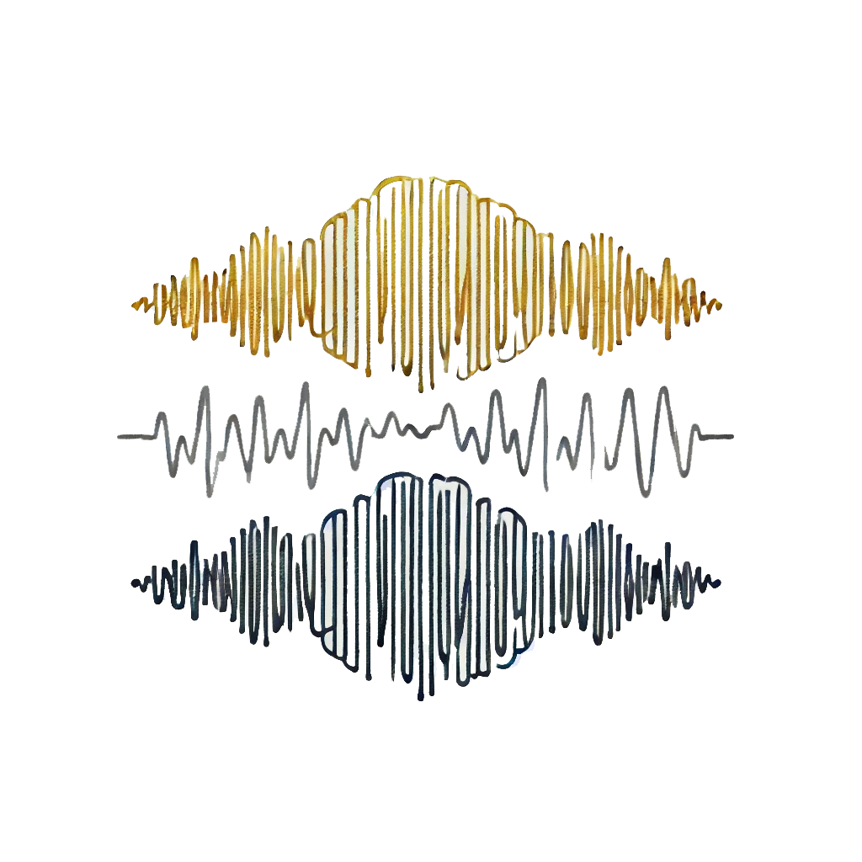
EEG Processing
An Entry to the World of Brain Waves
Intoduction to EEG
EEG Characteristics and Applications

Slide 2
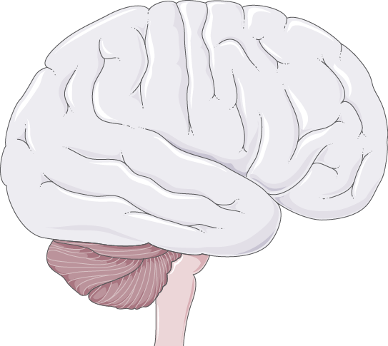
Session 1 Intoduction to EEG
EEG Characteristics and Applications

Slide 3
Table of contents
1
2
3
4
5
EEG Significance
EEG Recording
EEG Characteristics
What is EEG and Why it is Important?
EEG Recording and Electrode Placement
Specific EEG features & Comparison to other modalities
6
Types of Brain Waves
EEG Applications
EEG Limitations
Different EEG frequency bands
Clinical & Research applications of EEG
Noise and artifact & Low spatial resolution

Slide 4
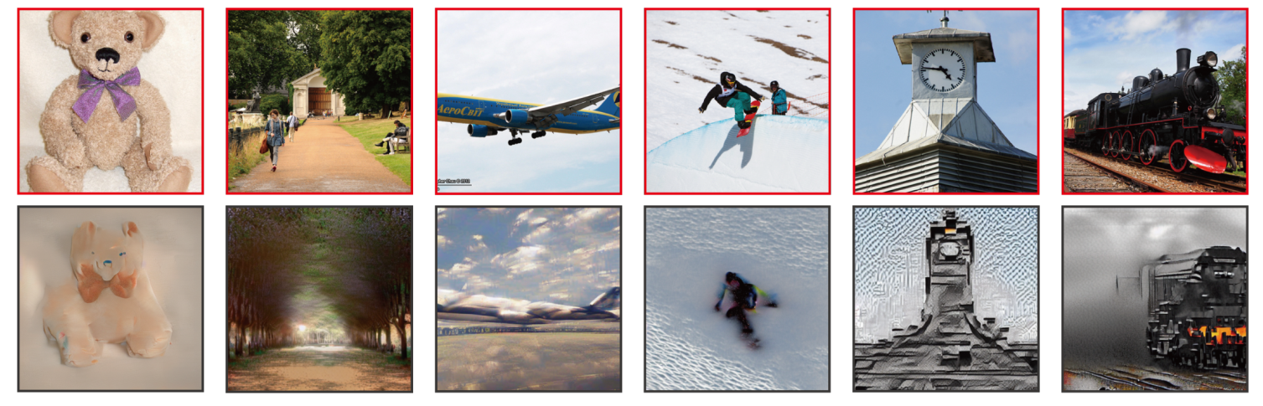
Sci-fi Movies Are Now a Reality!
See What They See: The Dawn of Thought Reconstruction!

Slide 5

1
EEG Significance
What is EEG and Why it is Important?

Slide 6
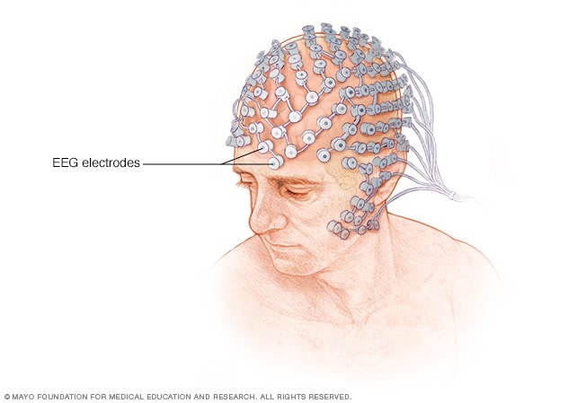
A Typical EEG Recording

Slide 7
What is EEG and Why it is Important?
A non-invasive method to record brain's electrical activity using scalp electrodes.
Clinical Importance: Diagnoses conditions like epilepsy, sleep disorders, and brain tumors.
Real-Time Monitoring: Crucial during surgeries and in intensive care units for monitoring brain function.
Research Utility: Helps study brain functions, cognitive processes, and effects of interventions.
Brain-Computer Interfaces (BCIs): Enables direct communication between the brain and external devices, aiding individuals with disabilities.

Slide 8
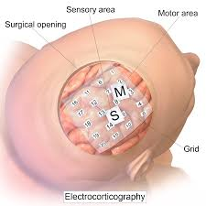
Non-invasive vs Invasive EEG

Slide 9

2
EEG Recording & Electrode Placement

Slide 10
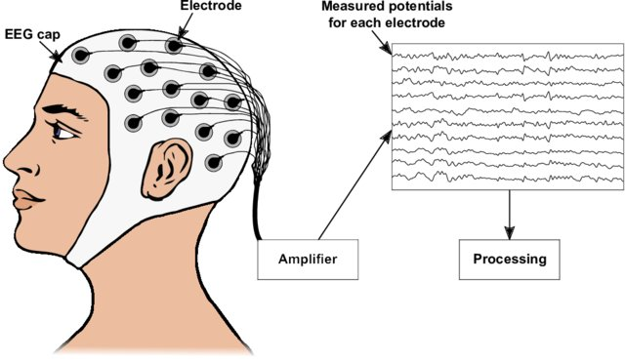
EEG Recording and Electrode Placement

Slide 11
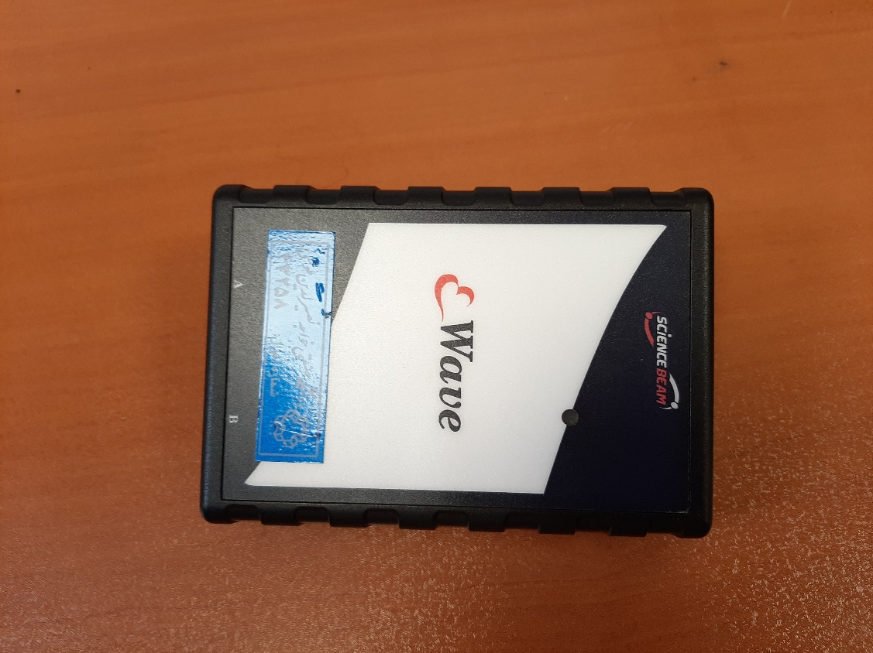
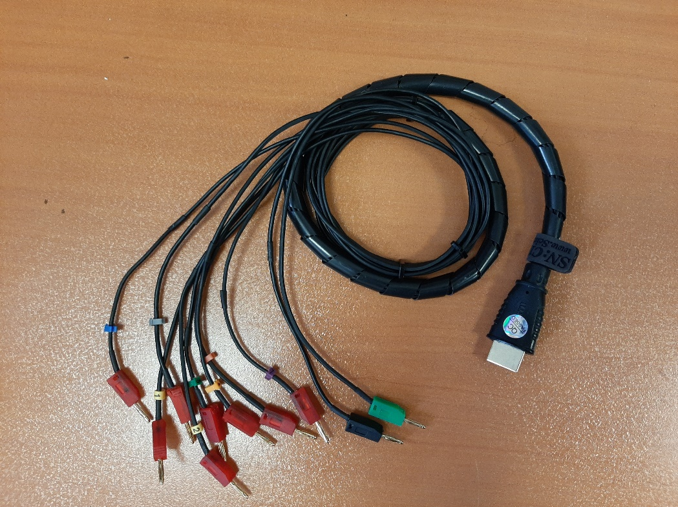
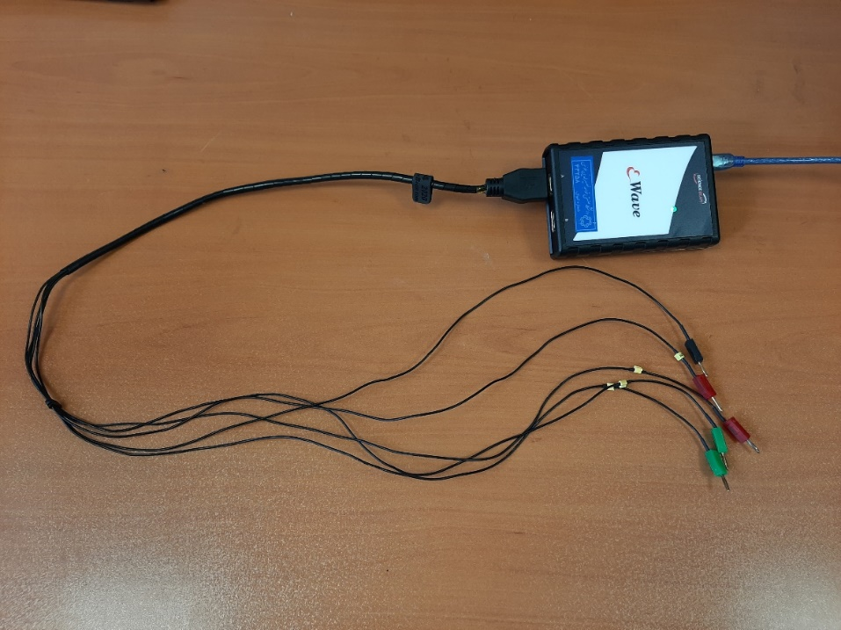
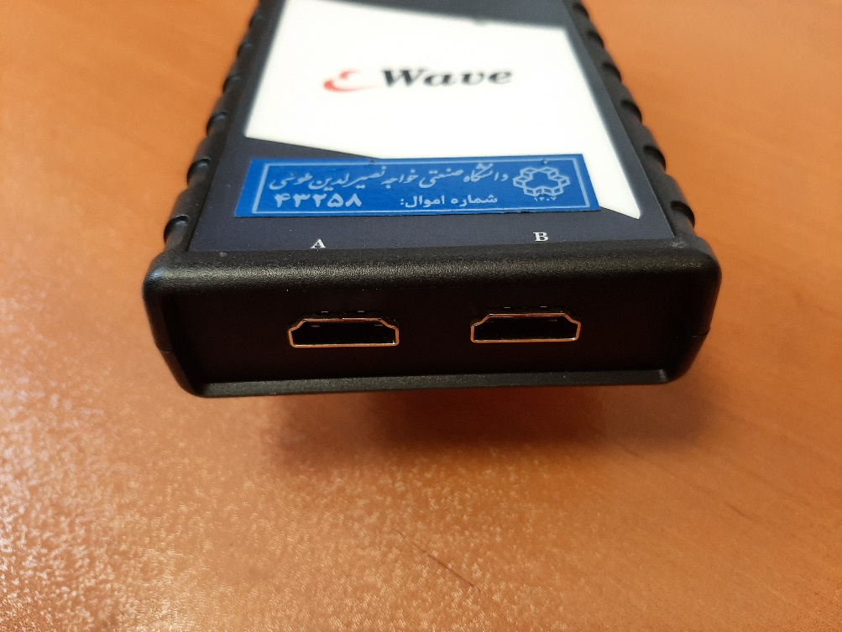
EEG Recording

Slide 12
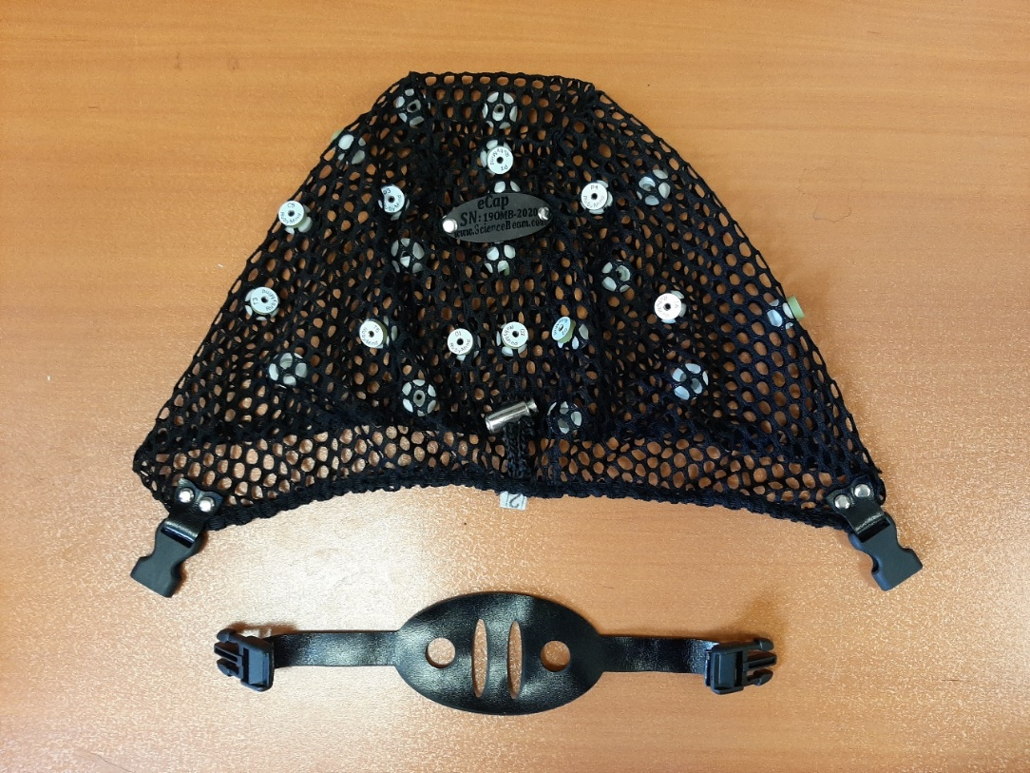
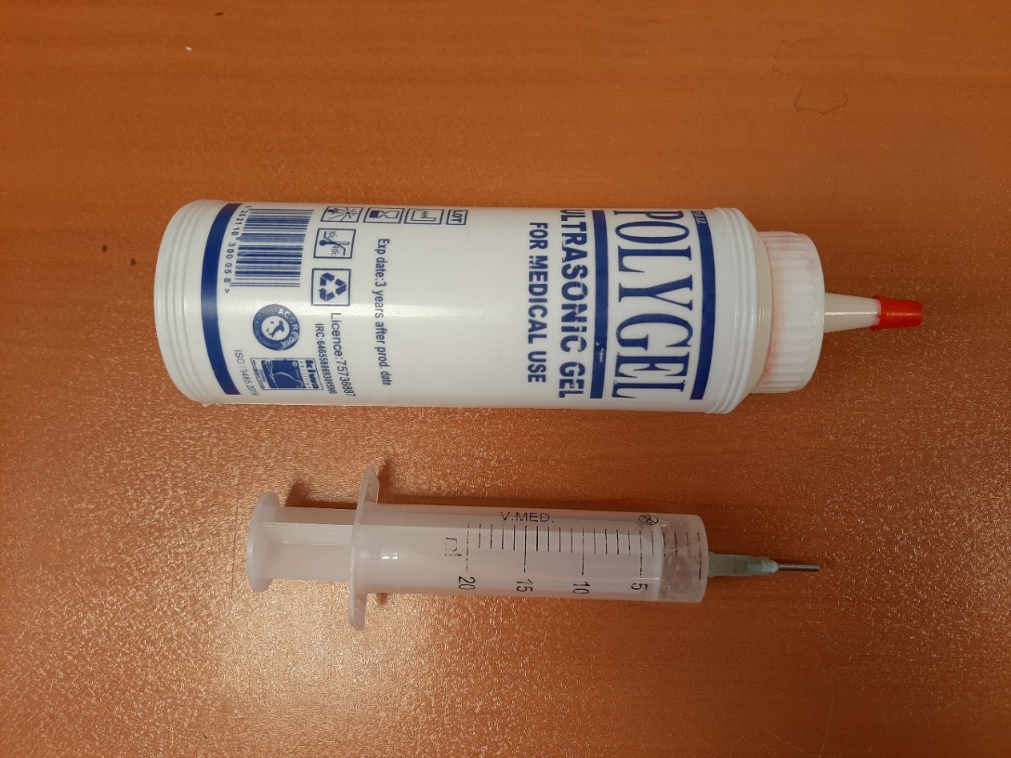
EEG Recording

Slide 13
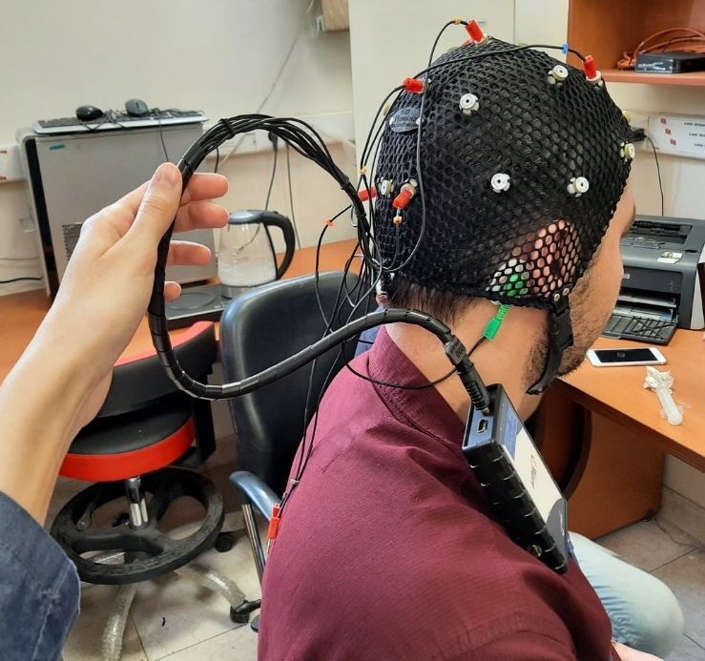
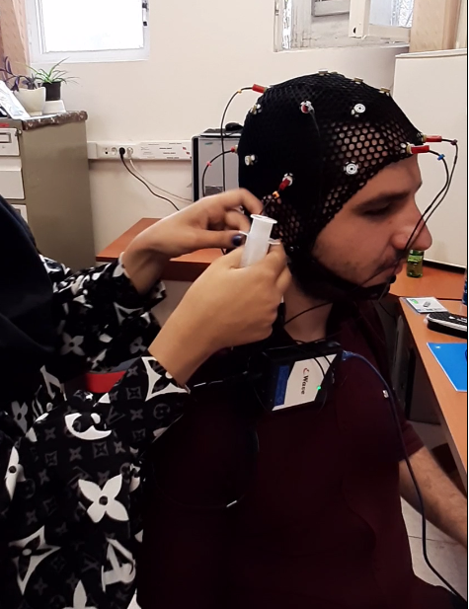
EEG Recording

Slide 14
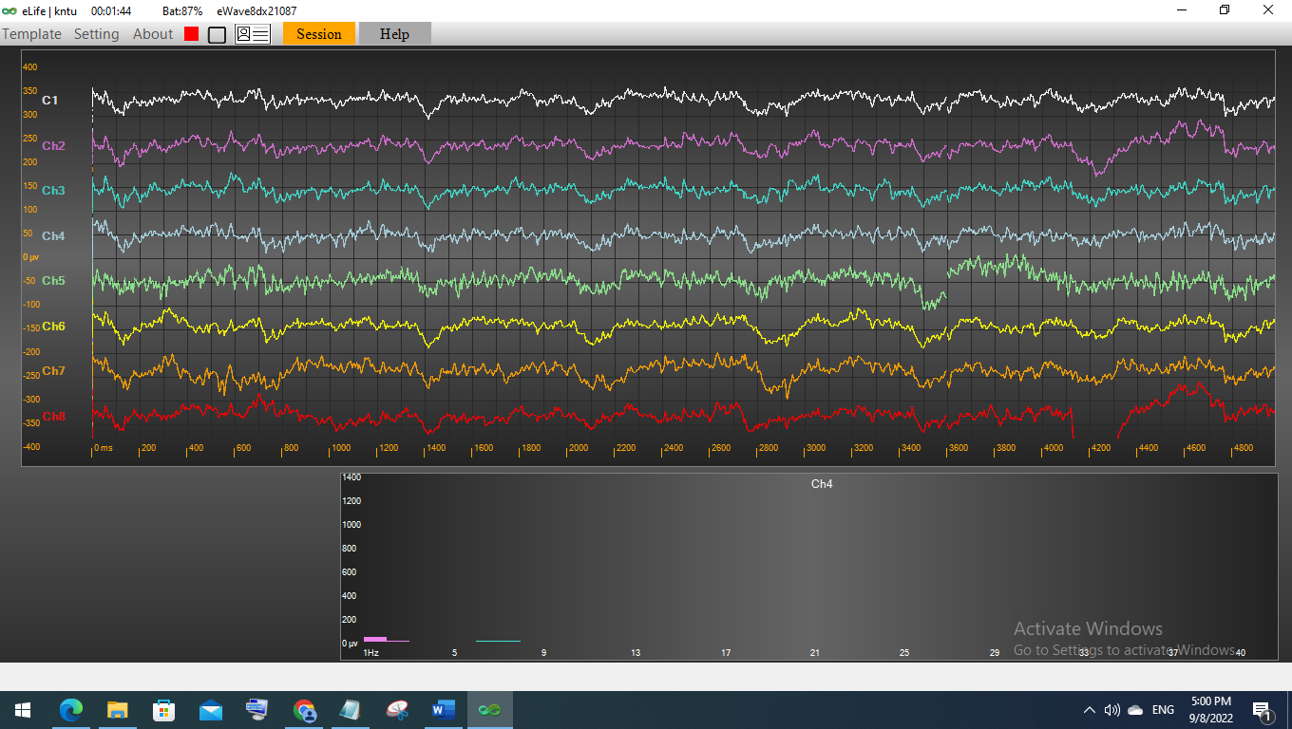
EEG Recording and Electrode Placement

Slide 15
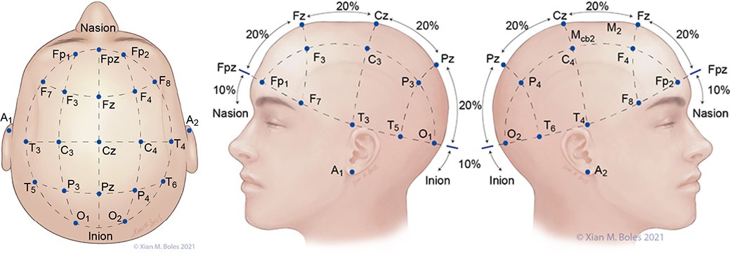
EEG Electrode Placement

Slide 16
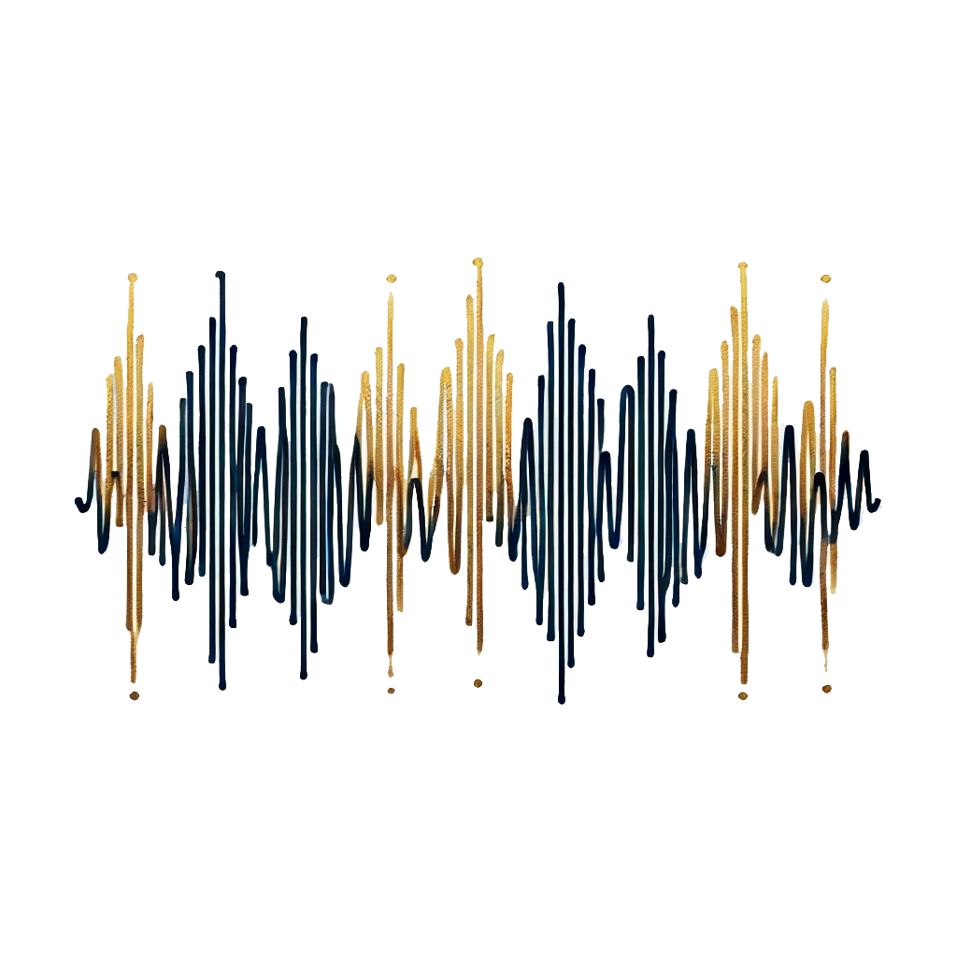
3
Characteristics of EEG Signals

Slide 17
Characteristics of EEG Signals
Aspect | EEG | MEG | fMRI | PET
Measurement | Detects electrical potentials. | Measures magnetic fields produced by neural activity. | Measures changes in blood oxygen levels (BOLD signals) correlating with neural activity. | Measures metabolic activity using gamma rays from radioactive tracers.

Slide 18
Characteristics of EEG Signals
Aspect | EEG | MEG | fMRI | PET
Spatial Resolution | Moderate; electrical signals are distorted by scalp and skull. | Better than EEG; magnetic fields are less distorted by scalp and skull, allowing more precise localization. | Superior; provides detailed images of brain structures. | Good; provides detailed images of brain metabolism and function, similar to fMRI.
Temporal Resolution | Excellent; captures brain activity on a millisecond timescale. | Excellent; captures brain activity on a millisecond timescale. | Poor; captures brain activity with a delay of a few seconds. | Poor; typically captures changes in brain activity over minutes.
Time to Process
Visual Recognition: 13 ms | Hearing: 20-50 ms | Touch: 10-20 ms | Simple Motor Response: 200-250 ms | Complex Cognitive Tasks: Hundreds of milliseconds to several seconds | Speech Processing: 200-600 ms (understanding), 600-1,000 ms (speaking)

Slide 19
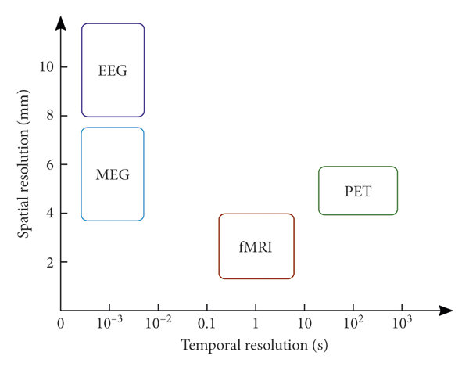
Characteristics of EEG Signals

Slide 20
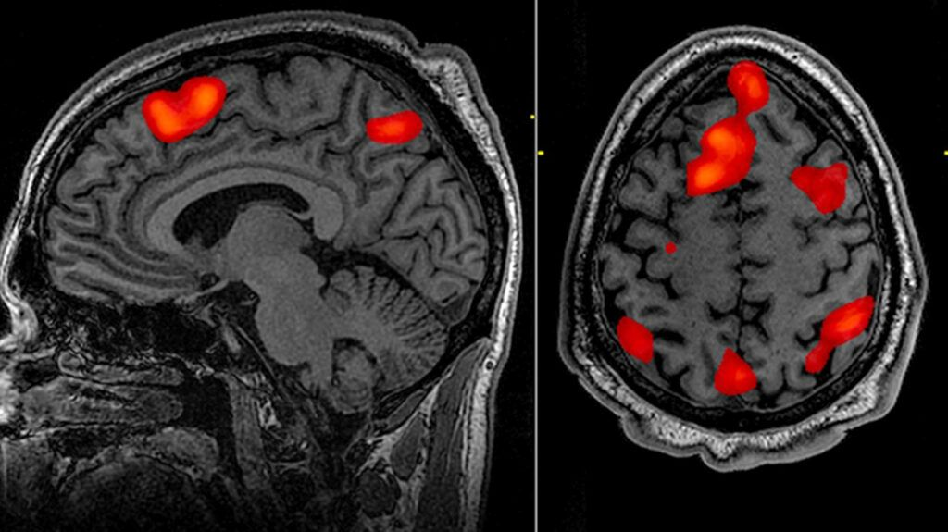
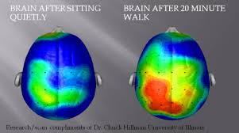
Spatial Resolution: fMRI vs. EEG
EEG
fMRI

Slide 21
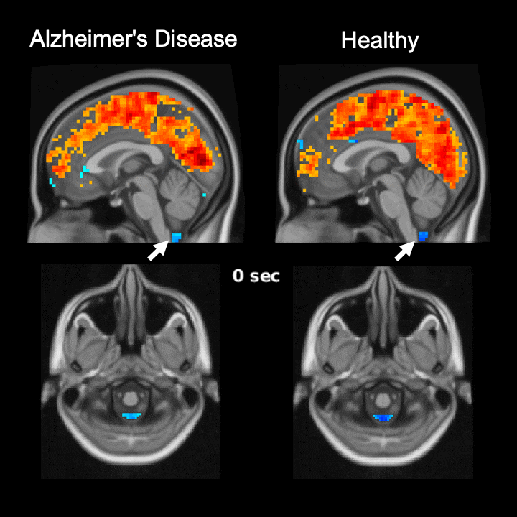
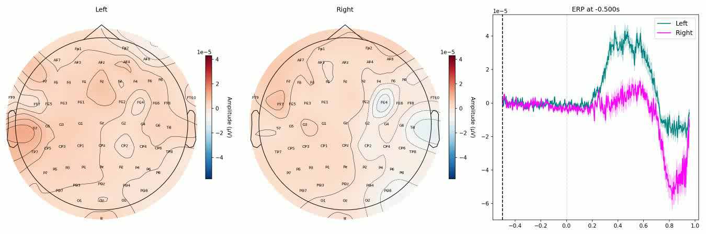
Temporal Resolution: fMRI vs. EEG
EEG
fMRI

Slide 22
Characteristics of EEG Signals
Aspect | EEG | MEG | fMRI | PET
Invasiveness | Non-invasive. | Non-invasive. | Non-invasive. | Invasive; involves radioactive tracers, posing health risks and limiting frequency of use.
Applications | Clinical diagnostics (e.g., epilepsy), cognitive research, continuous monitoring, brain-computer interfaces. | Source localization, mapping brain activity in response to sensory stimuli. | Mapping brain functions, identifying active brain regions during specific tasks. | Diagnosing and monitoring diseases like Alzheimer's and cancer, studying brain metabolism and neurotransmitter systems.

Slide 23

4
Types of Brain Waves

Slide 24
Types of Brain Waves
Name | Frequency Band | Characteristics | Occurrence and Significance
Delta | 0.5 - 4 Hz | High amplitude, low frequency waves. | Predominant during deep sleep and in some abnormal brain conditions.
Theta | 4 - 8 Hz | Medium amplitude and frequency. | Seen during light sleep, drowsiness, and in some cognitive tasks like memory encoding.
Alpha | 8 - 13 Hz | Moderate amplitude and frequency. | Common in relaxed, awake states, especially with closed eyes.
Beta | 13 - 30 Hz | Low amplitude, high frequency. | Associated with active thinking, focus, and alertness.
Gamma | 30 - 100 Hz | Very high frequency, low amplitude. | Linked to high-level information processing, perception, and consciousness.

Slide 25
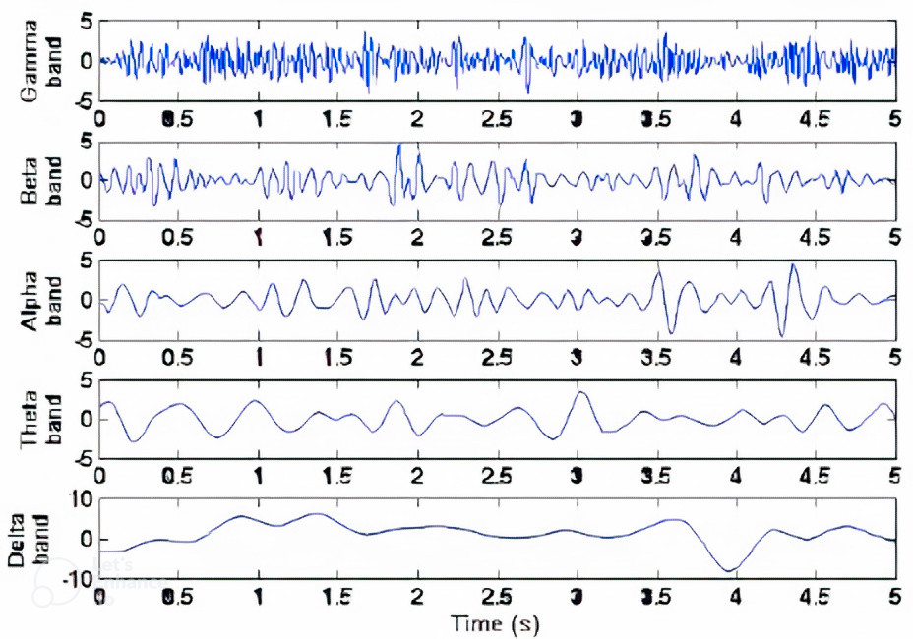
Types of Brain Waves

Slide 26
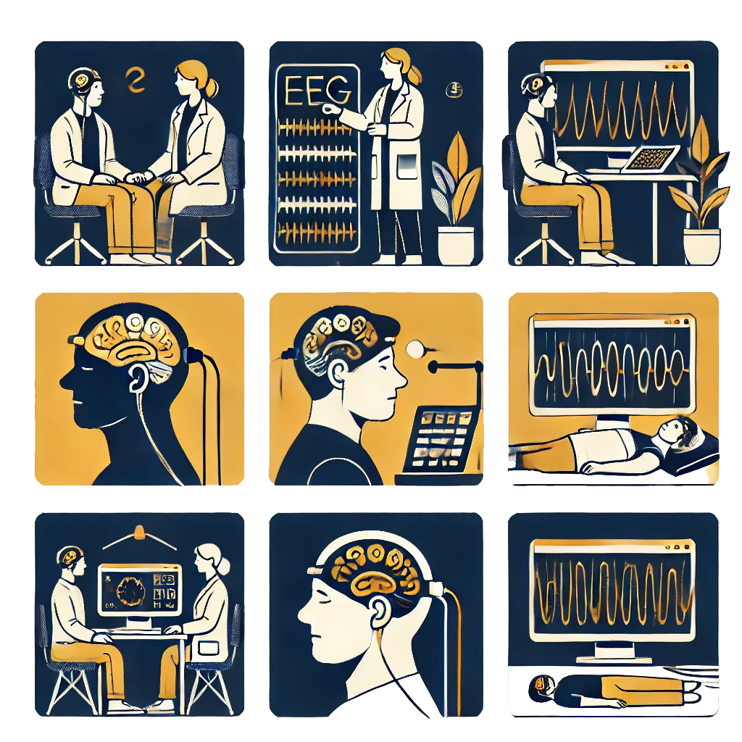
5
Applications of EEG Signals

Slide 27
Applications of EEG
1
2
3
BCI
Clinical Applications
Research Applications

Slide 28
Clinical Applications of EEG
Diagnosis of Epilepsy
Detects abnormal electrical activity in the brain.
Identifies patterns like:
Spikes: Sudden, sharp waves.
Spike-and-Wave Complexes: Spike followed by a slow wave.
Sleep Monitoring
Analyzes sleep patterns and diagnoses sleep disorders.
Sleep Stages:
REM Sleep: Low-amplitude, mixed-frequency waves.
NREM Sleep: Stages 1-3 with slower, higher amplitude waves.

Slide 29
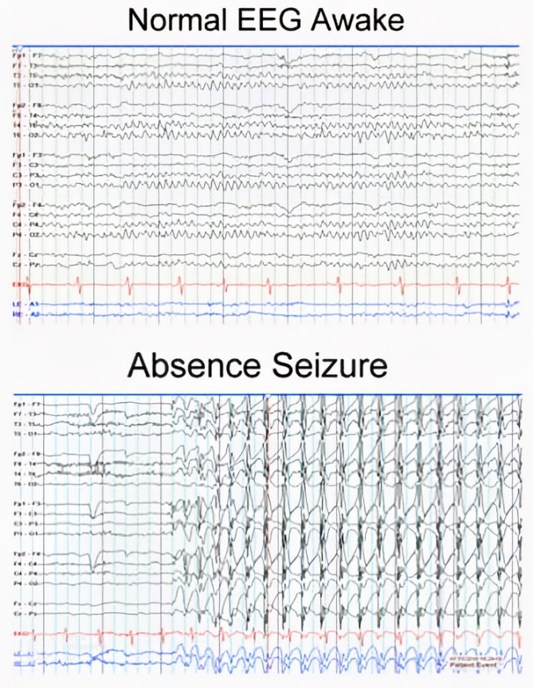
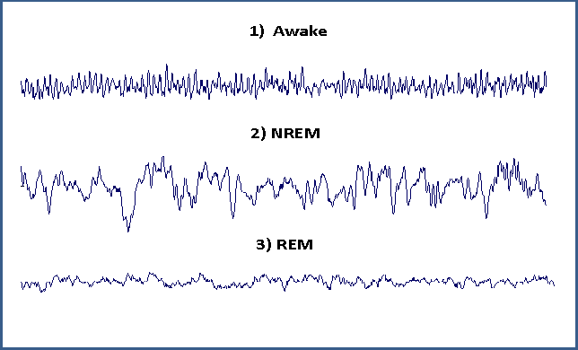
Clinical Applications of EEG

Slide 30
Research Applications of EEG
Cognitive Activity Studies
Measures brain activity during cognitive tasks such as:
Attention
Memory
Decision-making
Event-Related Potentials (ERPs):
Brain responses to specific sensory, cognitive, or motor events.
Useful for understanding the timing and neural mechanisms underlying cognitive processes.

Slide 31
BCI Applications of EEG
Brain-Computer Interfaces (BCIs)
Enables direct communication between the brain and external devices.
Applications of BCIs:
Assistive Technologies: Helps individuals with disabilities control computers or prosthetic limbs.
Neurorehabilitation: Assists in the recovery of brain functions after an injury by enabling patients to interact with their environment.
Controlling External Devices: Such as wheelchairs, drones, providing greater autonomy to users.

Slide 32
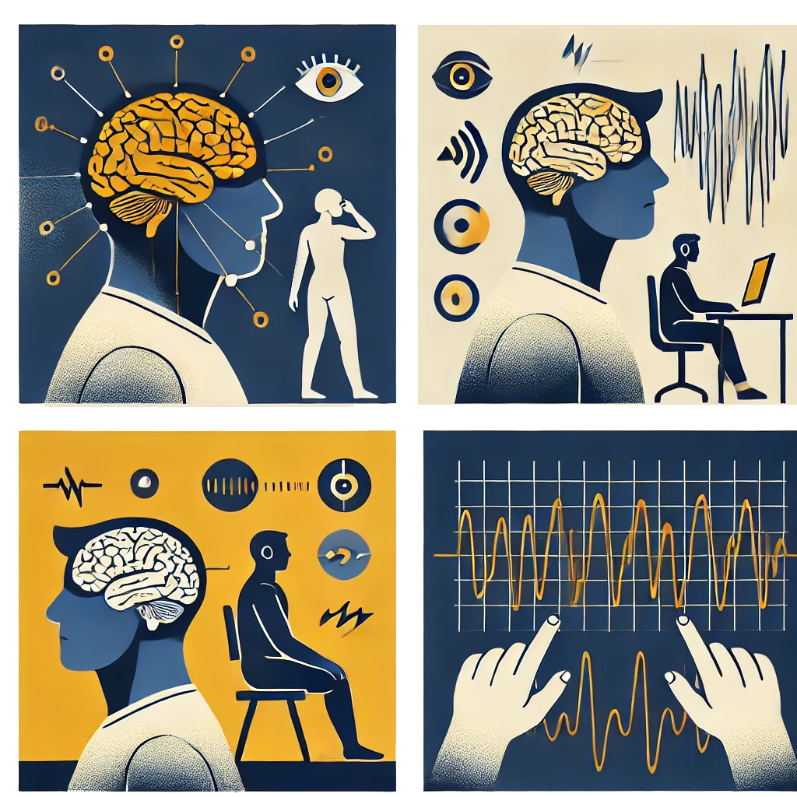
6
Limitations of EEG Signals

Slide 33
Limitations of EEG
Noise & Artifacts
Low Spatial Resolution

Slide 34
Limitations of EEG – Noise & Artifacts
Artifacts:
Unwanted effects on the EEG signal that have specific patterns and often have a known source.
Examples:
Eye Blinks: Large, slow frontal waves.
Heart Activity (ECG): Rhythmic, periodic waves.
Muscle Activity (EMG): High-frequency noise, identifiable patterns.

Slide 35
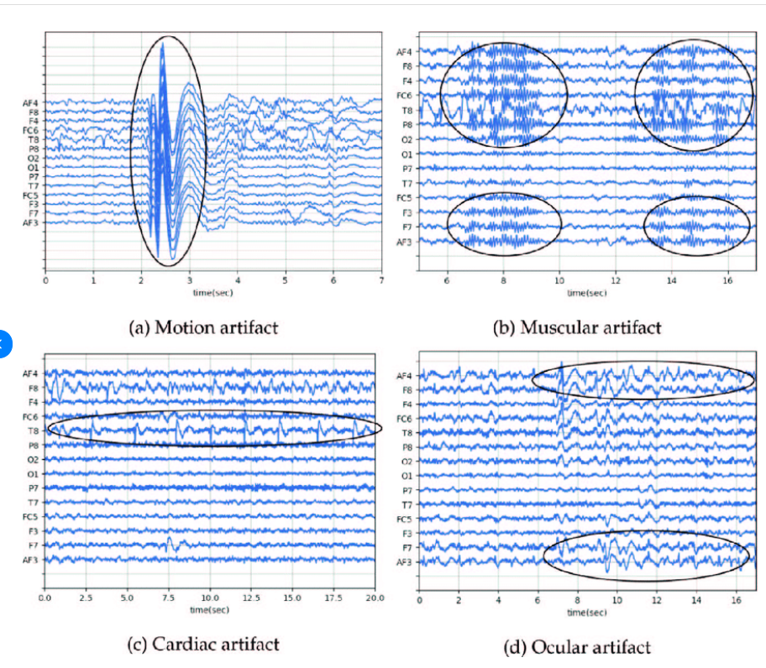
Limitations of EEG – Noise & Artifacts

Slide 36
Limitations of EEG – Noise & Artifacts
Noise:
Random, unwanted effects without specific patterns.
Examples:
Electrical Noise: 50Hz/60Hz mains electricity interference.
Other Electrical Interference: Irregular disturbances from electronic devices.

Slide 37
Limitations of EEG – Low Spatial Resolution
Localization Limitations:
Despite high temporal resolution, EEG cannot accurately pinpoint the source of neural activity.
Signals diffuse as they pass through the skull and scalp, leading to a loss of spatial specificity.
Combining EEG with other imaging techniques like fMRI or MEG can help mitigate these issues.

Slide 38
Thank You for Your Attention

